Slide 1














SCALABLE
GROUP 13
NGUYỄN TẤT BÁCH
NGUYỄN MINH ĐẠT - ITDSIU22166
NGUYỄN HOÀNG THIỆN - ITSIU22131
HÀ ANH KHOA - ITDSIU22128

Slide 2




TABLE OF CONTENT
INTRODUCTION
Data Understanding and Preparation
Exploratory Data Analysis
CONCLUSION
Model Development

Slide 3

PART 1:
INTRODUCTION

Slide 4


ABSTRACT
Customer retention is a critical focus for subscription-based services, with churn prediction playing a vital role in understanding and addressing customer behavior.
This project leverages Apache Spark to analyze customer data and identify key factors contributing to subscription cancellations by build predictive models to detect customers at risk of churning, provide actionable insights to develop strategies for reducing churn rates and support improved customer retention and long-term business growth.

Slide 5
PART 2:
DATA UNDERSTANDING AND PREPARATION

Slide 6
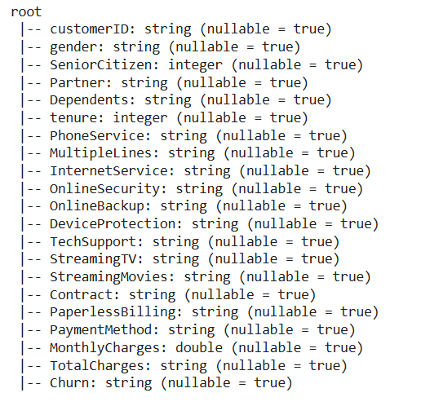
Raw data:
21 variables
7.043 observations

Slide 7
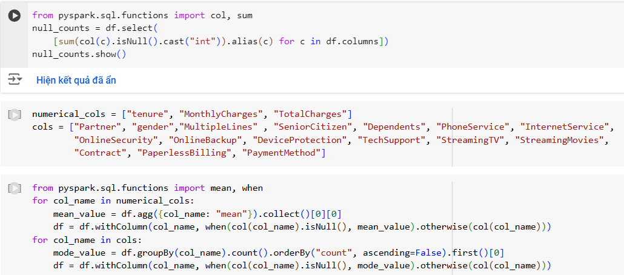
Preprocess the data by handling missing values

Slide 8
PART 3:
EXPLORATORY DATA ANALYSIS (EDA)

Slide 9
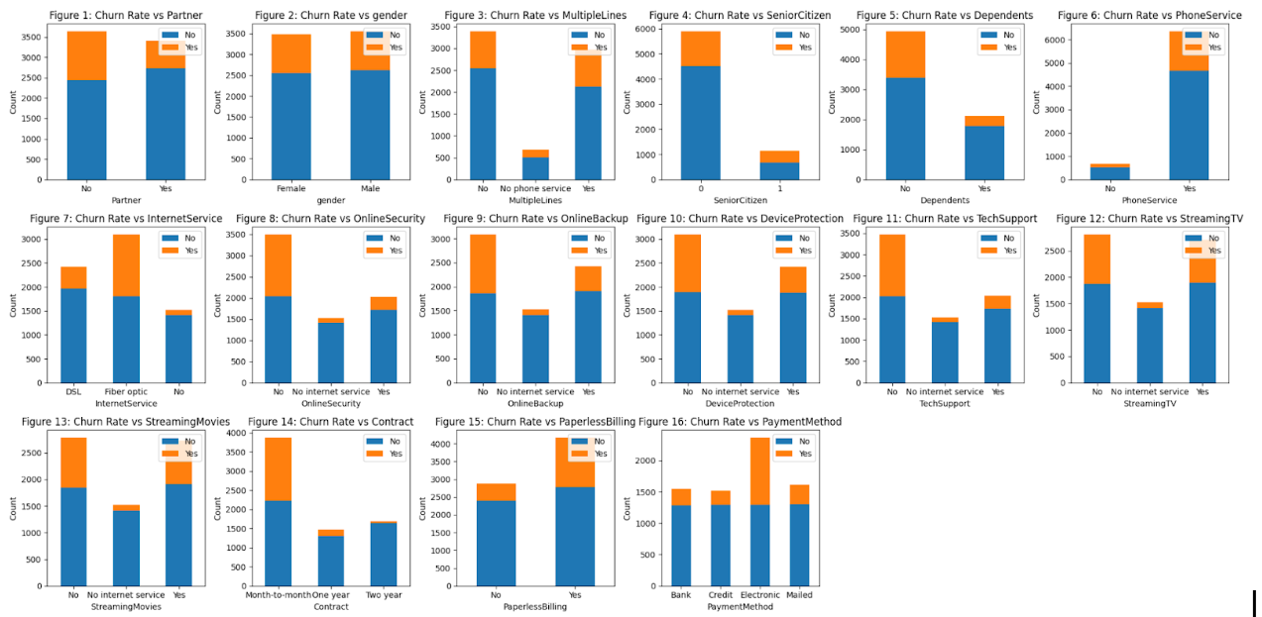
Visualize the correlation of Churn rate for each feature
A. Categorical features

Slide 10
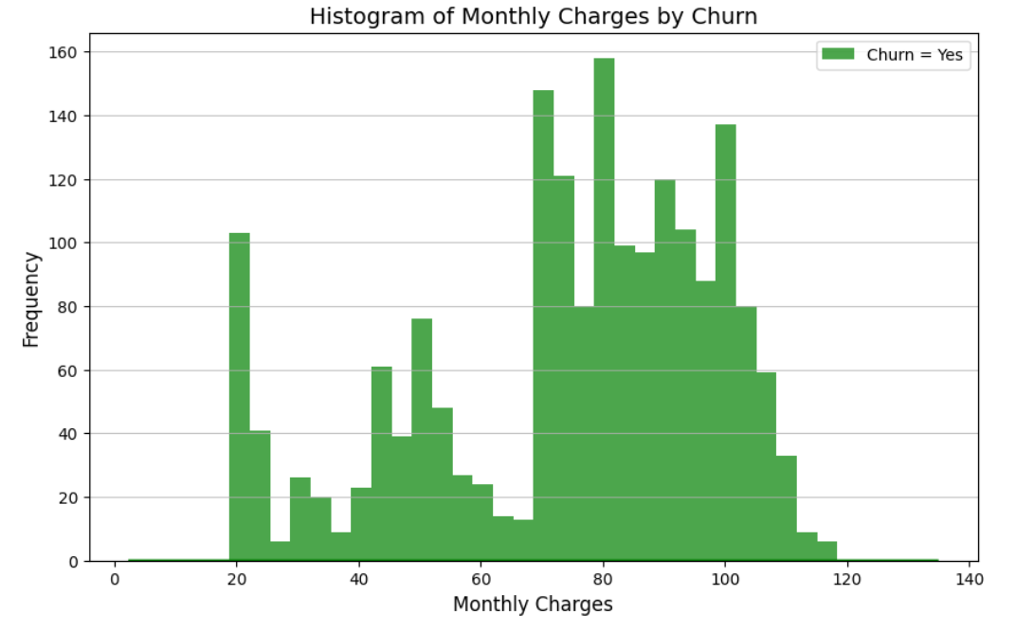
B. Numerical features

Slide 11
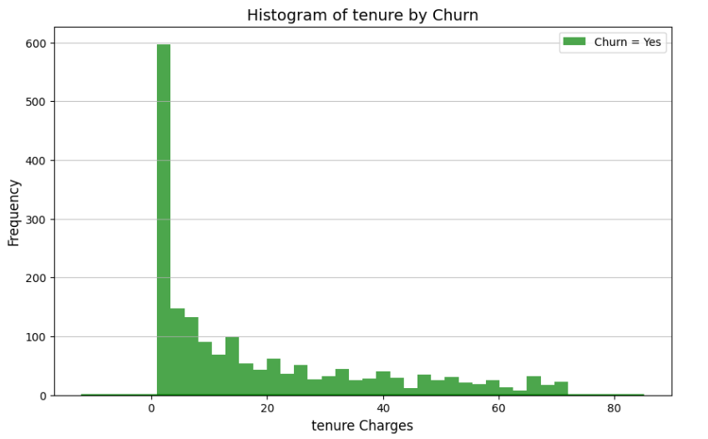
B. Numerical features

Slide 12
PART 4:
Model Development

Slide 13
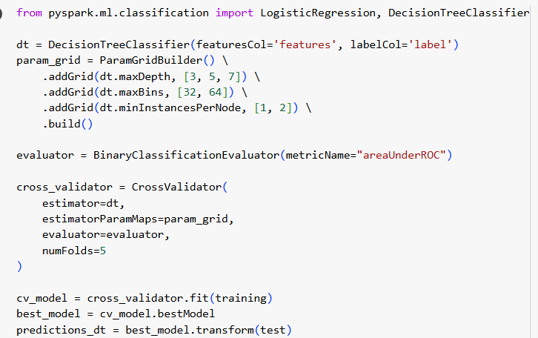

Decision Tree Classification

Slide 14
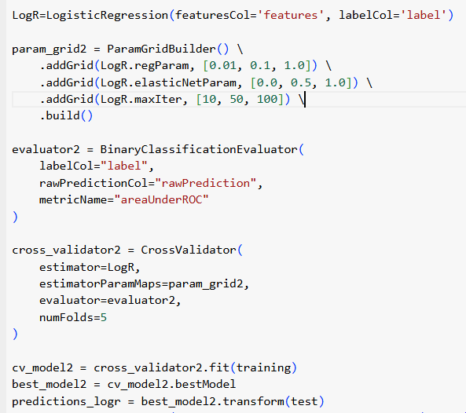

Logistic Regression

Slide 15
PART 5: CONCLUSION
Through exploratory data analysis, significant factors contributing to customer churn, such as numerical features like TotalCharges and tenure, were identified. The logistic regression model outperformed the decision tree model in terms of accuracy, primarily because logistic regression effectively handles numerical features and captures linear relationships, whereas decision trees may struggle with such data without proper preprocessing

Slide 16
THANK YOU VERY MUCH!

